Slide 1

Fundamentals of Politics Research
Lecture 10 (2020-21)
Bullshit
Dr Adrian Blau

Slide 2
Three types of bullshit
Harry Frankfurt | Phoniness, indifference to truth.
Jerry Cohen | Unclarifiable unclarity.
Adrian Blau | Obviously stupid.

Slide 3
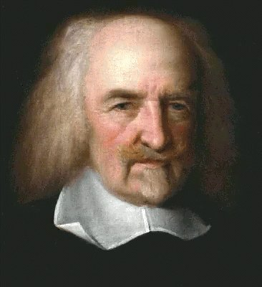
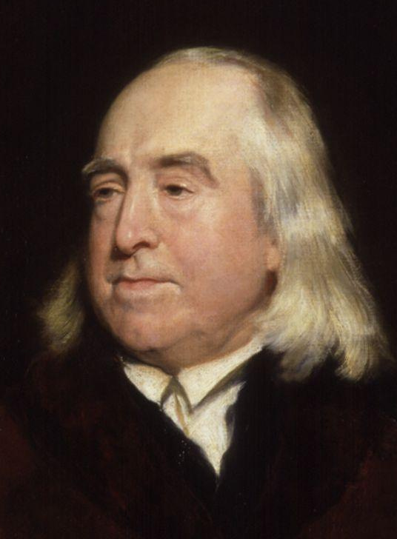
Nonsense
Thomas Hobbes:
  ‘meaningless vocal sounds’ (1650s).
Jeremy Bentham:
  talk of ‘natural rights is simple nonsense: natural and imprescriptible rights, rhetorical nonsense, nonsense upon stilts’ (1790s).

Slide 4
Why study bullshit?
Application of the concepts topic.
It’s educationally useful.
Lots of bullshit in politics (Frankfurt, Blau).
  Is politics institutionally bullshitty?
Lots of bullshit in politics research (Cohen, Blau).
  Is politics research institutionally bullshitty?
(Terminology: bullshit, BS, bull, nonsense.)
Abstract and concrete.

Slide 5
Frankfurt: bullshit vs. lies
‘the essence of bullshit is not that it is false but that it is phony’ (Frankfurt, p. 128).
‘The bullshitter … does not reject the authority of the truth, as the liar does, and oppose himself to it. He pays no attention to it at all. By virtue of this, bullshit is a greater enemy of the truth than lies are’ (132).
Comparison to alternatives.

Slide 6
Examples of Frankfurt-bullshit?
Frankfurt gives almost no specific examples of bullshit, except Wittgenstein/dog, which is not obviously bullshit.
Q. Where’s your homework?
A. The dog ate it.
A. The real question isn’t where my homework is, it’s why we have to do homework at all.
Examples are vital (but can be dangerous).

Slide 7
More examples
US high-school student, Shakespeare essay: ‘I absolutely did not think of my actions as a deliberate deception, but rather a filling of space with the inconsequential’ (Smagorinsky et al. 2010, 399).
‘History never happens. It can only ever happened’ (me, aged 20).
Mental state is the key.
But how can we see inside a person’s head? Ben Kotzee (2007, 172): ‘it is much harder to make an accusation of Frankfurt bullshit stick.’
The reader too.

Slide 8

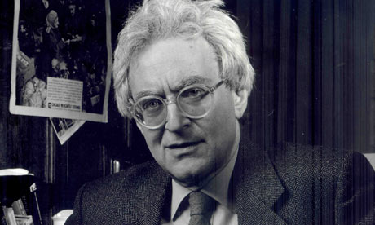

G.A. (Jerry) Cohen

Slide 9
Cohen-bullshit
(False dichotomy?)
‘a bullshit of ordinary life’ (Frankfurt) vs. ‘a bullshit that appears in academic works’ (96).
  Frankfurt’s notion of bullshit is agent-centred: ‘the bull, conceptually speaking, wears the trousers’. Cohen’s notion is output-centred: ‘the shit wears the trousers’ (97).
(Hardcastle 2006, 149-50: the unity of bullshit. Huh?)
Frankfurt: not caring is bad. Cohen: not making sense is also bad, and ‘nonsense is not nonsense because of … the nonsense-talker’s mental state’ (98).
Distinctions can be vital.

Slide 10
Unclarifiable unclarity
Cohen : bullshit is ‘unclarifiable unclarity’ (105).
    A sufficient condition: adding ‘not’ doesn’t affect its plausibility (105). (Really??)
Only gives one example, by Balibar (108), which makes some sense (Frankfurt 2002, 342). (Is bullshit scalar? See Eubanks & Schaeffer, 2008.)
Carnap on Heidegger’s ‘Das Nichts selbst nichtet’, i.e. ‘the nothing noths’ (see Hardcastle 2006, 143-8).
Conceptual criteria.
False dichotomy?

Slide 11


The Dresses of Yiqing Yin

Slide 12


The Dresses of Yiqing Yin

Slide 13
Léopold Lambert,
The Dresses of Yiqing Yin
‘The proper characteristic of a work of art is to enter into a universal relationship with the world. What it means is that this work exists as itself, independently, or rather beyond the intentions of its author. As far as Yiqing Yin’s dresses are concerned, [it] would not be diminishing them … to say that they are beautiful, beautiful in the deep sense of the word. Nevertheless, the vertigo I feel when I see them deserves to be questioned …. My answer to this question is located in the thousands of folds of Yiqing Yin’s dresses.’

Slide 14



Léopold Lambert,
The Dresses of Yiqing Yin
‘Each of these folds seems to correspond to a small perception of the wearer’s body. The body is dressed, yet it seems somehow stripped and offering an epidermic relationship to the world surrounding it. … the almost infinite multiplication of the epidermic surface allows the body to irradiate its emotions and its desires as expressed at a molecular level.’
➔ May or may not involve Frankfurt-bullshit.
➔ Unclarifably unclear.

Slide 15
‘Why one kind of bullshit flourishes in France’
‘what I have read of Jacques Derrida, Gilles Deleuze, Jacques Lacan, and Julia Kristeva leads me to think that there is a great deal of bullshit in their work’ (108).
Cohen’s claim is unscholarly.
Culler (2003, 43-7): we should read things in context; and we should distinguish between poor writing and poor thinking.
Lost in translation? Spoken/written?

Slide 16
Unclarifiable unclarity?
Frankfurt (2002, 341-2): Cohen doesn’t define ‘unclarifiable’.
  Cohen (105): ‘Something is unclarifiable if and only if it cannot be made clear, but I shall not try to say what “clear” means in this essay. (I’m inclined to think it’s not possible to do so, in an illuminating way.)’
Yet any unclear comment might be translatable into something clear. Is anything necessarily unclarifiable?
Doesn’t this again come down to mental states?

Slide 17
Extending Cohen
Unclear but unclarifiable.
When clarified, a legitimate proposition.
When clarified, illogical or incorrect.
Clear, but on inspection, illogical or incorrect.
Qualify (c) and (d): could reasonably have known better.
‘Illogical or incorrect’ may be wrong. My account is in its early days – and not just ‘my’ account (see Mark Evans 2006, 199).
Cohen-bullshit.
Not bullshit.
Blau-bullshit.
Blau-bullshit.

Slide 18
A widely recognised problem
Hobbes, Bentham, George Orwell’s ‘Politics and the English language’.
‘Knowledge is power.’
We all write such things.
Rorty: ‘they think they’re thinking’ (see Dennett 2007). But we all say things we don’t really understand or which we would reject if we thought more about them.

Slide 19
Three conceptions of bullshit
Not all-or-nothing, exclusive, or exhaustive!
Frankfurt: phoniness, indifference to truth.
  e.g. ‘The real question isn’t whether I was wrong, it’s ….’
Cohen: unclarifiable unclarity – can’t be translated into something that makes sense.
  e.g. ‘The proper characteristic of a work of art is to
  enter into a universal relationship with the world.’
Blau: obviously stupid, i.e. the speaker/
writer could reasonably have been expected
to reject the claim. e.g. ‘Knowledge is power.’
Agent-centred
Output-centred, maybe agent-centred too
Output-centred and agent-centred

Slide 20
Three conceptions of bullshit
Q. Where is your homework?
The dog ate it.
A. The real question is what right you have to ask me that.
A. Homework is as homework does.
A. I didn’t know I had to do the homework, because knowledge is power, I don’t have any power, so I didn’t know about the homework.
A lie.
Frankfurt-bullshit.
Cohen-bullshit.
And also maybe Frankfurt-bullshit.
Blau-bullshit.

Slide 21

Bullshit –
or not?

Slide 22
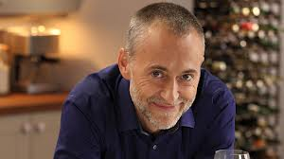
Michel Roux Jr.
From Food and Drink (11 February, 2013)
‘There’s nothing I’m more passionate about than what, how and why we eat and drink. … Something I’m obsessed by, just as you are, is a phenomenon that has literally taken over the world: baking. We’ve
gone cupcake-crazy! …
[etc.]’

Slide 23


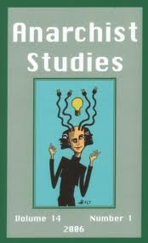


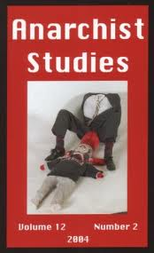
From Anarchist Studies
Power isn’t necessarily bad, because ‘power is energy, and “energy is eternal delight” ’.

Slide 24
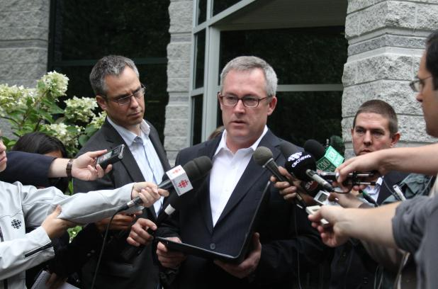


‘Safety is our number one priority.’

Slide 25
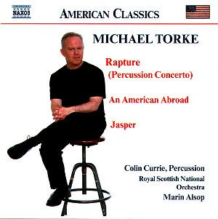
Michael Torke
‘Music, like theatre, happens in time. Unlike a painting, which the viewer can understand in a flash, music must unfold through time, filling up time, and is a slave to time to make itself manifest. Yet, unlike theatre, which is effective in storytelling, music has the capacity to suspend time, to make us forget time. Storytelling takes us from A to B with the anticipation of C. ... [In the music on this CD] the melodies and rhythms may sound directional, as the foreground aural experience seems to transport us from one point to the next, but overall the music expresses a kind of celebration of itself, a sustained feeling for its own sake.’

Slide 26

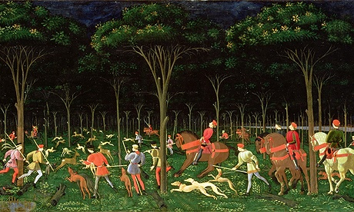
Mark Sheerin, on
Mocksim’s Twin Towers
‘If politics is the continuation of war by other means, perhaps the same might be said of art with reference to the Catholic crusades of the 12th and the 13th centuries. … [But] the geometrical certainties of the Christian era now meet a challenge in the form of the two hijacked planes which flew into the Word Trade Centre on September 11 2001. Until that point the horizon of the world was guaranteed by a superpower. … Mocksim has removed the horizon from his ghostly scenes. His towers hover in a virtual space, as infinite as the justice swiftly promised by US foreign policy in the wake of the attack. It is a virtual space which denies us the chance to define what might have just happened.’

Slide 27
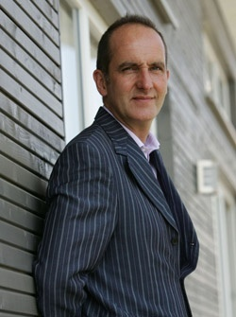

Kevin McCloud
From Grand Designs (31 October, 2012):
‘This building seems to analyse and reinterpret your relationship with the outdoors. … It gets that fine balance between wanting to enjoy nature and be part of it.’

Slide 28
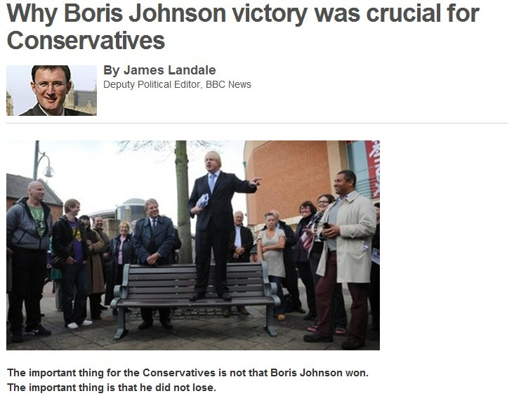
‘The important thing for the Conservatives is not that Boris Johnson won. The important thing is that he did not lose.’
— James Landale, BBC News website (4 May 2012)

Slide 29
Derrida (in Borradori 2003, 85-6) on 9/11 (called bullshit by Brian Leiter)
‘… this act of naming: a date and nothing more. … [T]he index pointing toward this date, the bare act, the minimal deictic, the minimalist aim of this dating, also marks something else. Namely, the fact that we perhaps have no concept and no meaning available to us to name in any other way this “thing” that has just happened … But this very thing … remains ineffable, like an intuition without concept, like a unicity with no generality on the horizon or with no horizon at all, out of range for a language that admits its powerlessness and so is reduced to pronouncing mechanically a date, repeating it endlessly, as a kind of ritual incantation, a conjuring poem, a journalistic litany or rhetorical refrain that admits to not knowing what it’s talking about.’

Slide 30
BlauBlog
http://adrianblau.wordpress.com/2013/05/11/is-derrida-full-of-bullshit-part-1/
http://adrianblau.wordpress.com/2013/05/26/is-derrida-full-of-bullshit-part-2/
http://adrianblau.wordpress.com/2013/06/13/tv-bullshit-and-its-effect-on-clear-thinking/

Slide 31
Conclusions
Examples help.
Bullshit is in the eye of the beholder.
There’s bullshit in all of us.
Not caring (Frankfurt), not being clear (Cohen) and not having a good argument (Blau) are all bad.
Not caring is often the basis of not being clear and/or not having a good argument.

Slide 32
Extra references not on reading list
Derrida 2003 — see Borradori, Giovanna. 2003. Philosophy in a Time of Terror: Dialogues with Jürgen Habermas and Jacques Derrida. Chicago: University of Chicago Press.
Dennett, Daniel, 2007. [Comments on Rorty, online at www.slate.com/id/2168488.]
Eubanks, Philip, and John Schaeffer, 2008. A kind word for bullshit: the problem of academic writing, College Composition and Communication 59:3, 372-88. Downloadable from http://writing2.richmond.edu/training/383/383restricted/bullshit.pdf.
Kotzee, Ben. 2007. Our vision and our mission: bullshit, assertion and belief. South African Journal of Philosophy 26:2, 163-75.
Smagorinsky, Peter, Elizabeth Anne Daigle, Cindy O’Donnell-Allen, and Susan Bynum, 2010. Bullshit in academic writing: a protocol analysis of a high school senior’s process of interpreting much ado about nothing, Research in the Teaching of English 44:4, 368-405.

